Slide 1
Hypothesis Testing

Slide 2
Learning Goals
In this section, we will cover:
- Overview of hypothesis testing
- Bayesian approach to hypothesis testing
- An example of hypothesis testing involving coin-tossing
- Hypothesis testing terminology including Type I and Type II errors
- Examples of Hypothesis tests in practice
- Hypothesis testing: significance level and p-values
- Power and sample size considerations
- Correlation vs. causation
- Confounding variables
- Examples of spurious correlations

Slide 3
Hypothesis Testing
A hypothesis is a statement about a population parameter.
We create two hypotheses:
- The null hypothesis (H₀)
- The alternative hypothesis (H₁ or H_{A})
We decide which one to call the null depending on how the problem is set up.

Slide 4
Hypothesis Testing: Decision Rules
A hypothesis testing procedure gives us a rule to decide:
- For which values of the test statistic do we accept H₀.
- For which values of the test statistic do we reject H₀ and accept H₁ .
You may hear some people say that you can reject H₀, but that you never accept H₁ .
Here, this doesn't matter very much, since we're using hypothesis testing in order to decide which of two paths to take in the project.

Slide 5
Hypothesis Testing: Bayesian Approach
In the Bayesian interpretation (example to follow), we don't get a decision boundary.
Instead, we get updated (posterior) probabilities.

Slide 6
Coin Tossing Example
You have two coins:
- Coin 1 has a 70% probability of coming up heads.
- Coin 2 has a 50% probability of coming up heads.
Pick one coin without looking.
Toss the coin 10 times and record the number of heads.
Given the number of heads you see, which of the two coins did you toss?

Slide 7
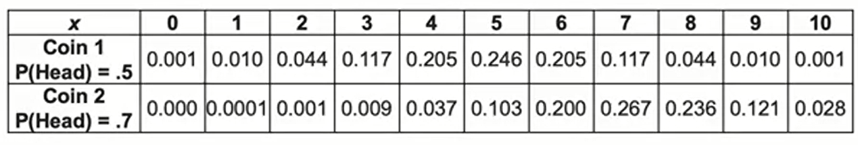
Coin Tossing Example: Likelihood Ratio
Given what we know about coins 1 and 2, we can make a table of the probability of seeing x heads out of 10 tosses.
We can now calculate a likelihood ratio, based on the number of heads we saw when tossing the unidentified coin.

Slide 8
Coin Tossing Example: Likelihood Ratio
Suppose we saw three heads:
- P1(3)/P2(3) = 0.117/0.009 = 13
- Coin 1 was 13 times more likely to give us the output (3 heads) than coin 2.
- We call this the likelihood ratio.

Slide 9
Hypothesis Testing: Bayesian Interpretation
In the Bayesian interpretation, we need priors for each hypothesis:
- In this case, we randomly chose the coin to flip
- P(H₁ = we chose coin 1) = 1/2 and
- P(H₂ = we chose coin 2) = 1/2
Since we have no way, before seeing the data, to determine the coin that was chosen, we just assign 1/2 to each.

Slide 10
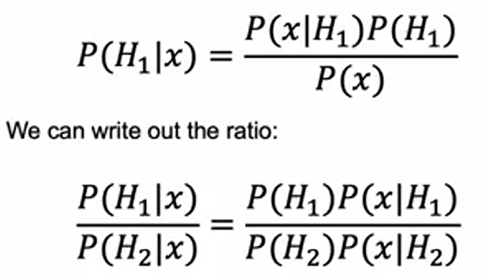
Hypothesis Testing: Bayesian Interpretation
Priors: P(H₁) = 1/2 = P(H₂) = 1/2
Updating priors after seeing the data 3 heads (Bayes' Rule):

Slide 11
Hypothesis Testing: Bayesian Interpretation
The priors are multiplied by the likelihood ratio, which does not depend on the priors.
The likelihood ratio tells us how we should update the priors in reaction to seeing a given set of data!

Slide 12
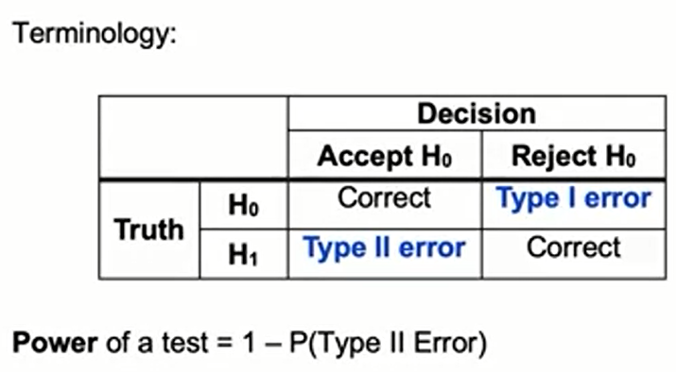
Neyman-Pearson Interpretation
The Neyman-Pearson paradigm (1933) is non-Bayesian.
This gives an up or down vote on H₀ vs H₁

Slide 13
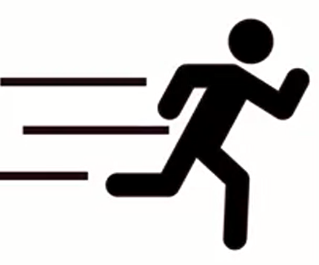
Example: Customer Churn
Customer churn occurs when a customer leaves a company
Data related to churn may include a target variable for whether or not the customer left
Features could include:
-The length of time as a customer
- The type and amount purchased
- Other customer characteristics
Churn prediction is often approached by predicting a score for individuals that estimates the probability the customer will leave.

Slide 14
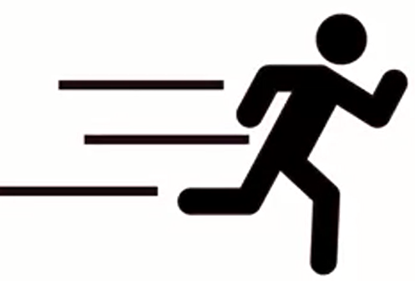
Customer Churn: Type I vs. Type II Error
Suppose we use data on customer characteristics to predict who will churn over the next year.
In our data, customers who have been with the company for longer are less likely to churn.
This could be due to an underlying effect, or due to chance:
- A Type 1 Error occurs when this effect is due to
chance, but we find it to be significant in the model.
- A Type II Error occurs when we ascribe the effect
to chance, but the effect is non-coincidental.

Slide 15
Hypothesis Testing: Terminology
The likelihood ratio is called a test statistic: we use it to decide whether to accept/reject H₀.
The rejection region: is the set of values of the test statistic that lead to rejection of H₀.
The acceptance region: is the set of values of the test statistic that lead to acceptance of H₀.
The null distribution: is test statistic's distribution when the null is true.

Slide 16
Hypothesis Testing: Marketing Intervention
Testing marketing intervention effectiveness:
- For a new direct mail marketing campaign to existing customers, the null hypothesis (H₀), suggests the campaign does not impact purchasing.
- The alternative hypothesis (H₁), suggests it has an impact.

Slide 17
Hypothesis Testing: Website Layout
Testing a change in website layout:
- For a proposed change to a web layout, we may test a null hypothesis (H₀) that the change has no impact on traffic.
- Here, we would look for evidence to reject the null in favor of an alternative hypothesis (H₁, that there is an impact on traffic).

Slide 18
Hypothesis Testing: Product Quality/Size
Testing whether a product meets expected size threshold:
- Suppose a product is produced in various factories, with expected size S
- To confirm that the product size meets the standard within a margin of error,
the company might:
• randomly sample from each production source,
• establish H₀ (product size is not significantly different from S),
• and H₁ (there is a significant deviation in product size),
• test whether H₀ can be rejected in favor of H₁, based on the observed
mean and standard deviation.

Slide 19
Significance Level and P-Values
We know the distribution of the null hypothesis.
To get a rejection region, we calculate the test statistic.
We will choose, before testing the data, the level at which we will reject the null hypothesis.

Slide 20
Significance Level and P-Values
A significance level (α) is a probability threshold below which the null hypothesis will be rejected.
We must choose an a before computing the test statistic! If we don't, we might be accused of p-hacking.
Choosing α is somewhat arbitrary, but often .01 or .05.

Slide 21
Significance Level and P-Values
Important terminology:
The p-value: smallest significance level at which the null hypothesis would be rejected.
The confidence interval: the values of the statistic for which we accept the null.

Slide 22
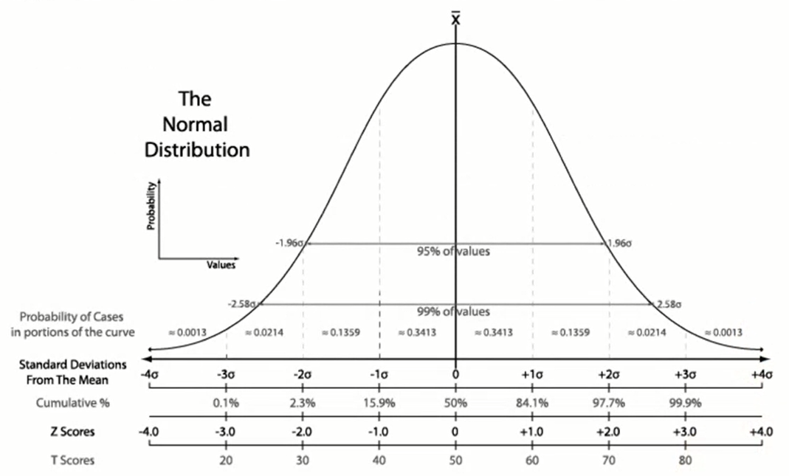
Significance Level and P-Values

Slide 23
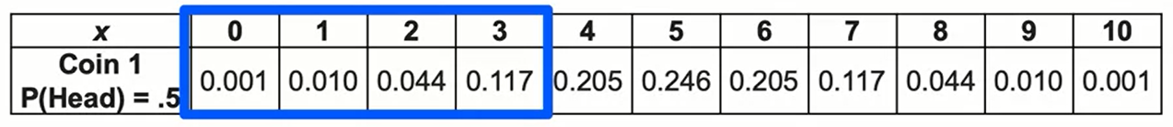
Coin Tossing Example: p-value
Suppose we saw three heads in 10 rolls:
- P(3 or less heads) = P(0 heads) + P(1 head) + P(2 heads) + P(3 heads) =~ 17% - Under the null hypothesis, a value this extreme occurs 17% of the time

Slide 24
Hypothesis Testing: Coin Tossing
In the coin tossing example:
- H₀: the coin is fair and P(H) = .5
- H₁: the coin is unfair and P(H) < .5
How can we test the null hypothesis if we observe 3 heads in 10 flips?
Testing the null hypothesis:
- We know H₀ is distributed binom(10,.5).
- Choose a p-value cutoff (more on p-values soon), say 5%.
- Calculate the CDF of 3 heads from a binom(10,.5).
- CDF = 17.1% (above our cutoff)
- This is > 5%, so we don't reject H₀.

Slide 25
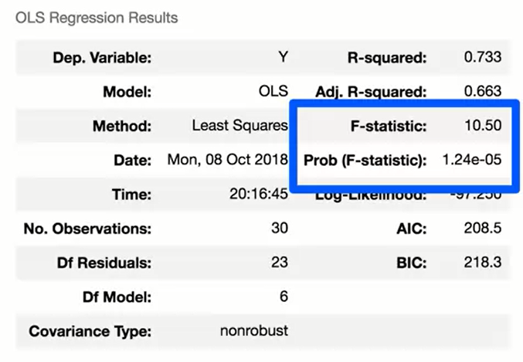
F-Statistic
H₀ : the data can be modeled by setting all betas to zero.
Reject the null if the p-value is small enough.

Slide 26
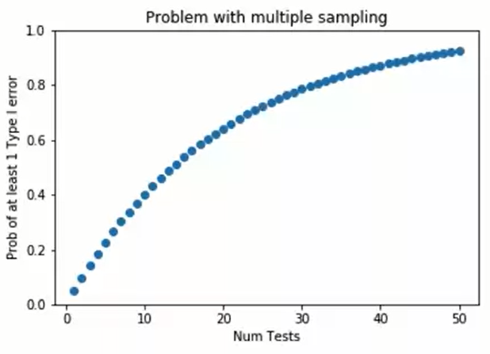
Power and Sample Size
If you do many 5% significance tests looking for a significant result, the chances of making at least one Type I error increase.
Probability of at least one type I error is approximately = 1 – (1 – 0.05)^{#tests}
This is roughly 0.05 x (# tests), if you have 10 or fewer tests.

Slide 27
Power: Bonferroni Correction
The Bonferroni Correction: says "choose P_{threshold} so that the probability of making a Type I error (assuming no effect) is 5%".
Typically choose: P_{threshold} = 0.05 / (# tests)
Bonferroni Correction allows the probability of a Type I error to be controlled, but at the cost of power.
Effects either need to be larger or the tests need larger samples, to be detected.
Best practice is to limit the number of comparisons done to a few well-motivated cases.

Slide 28
Does It Rain More On Cooler Days?
We associate rain with cold weather.
Does it actually rain more when days are cooler?
Maybe it depends on where you are.
Some places have summer monsoons, so maybe as it gets warmer there, it rains more.
- Warmer weather increases evaporation, which can increase humidity. In warm weather, there is water in the air to form precipitation. This mechanism would suggest warmer weather → more rain.
- Cooler weather decreases dew point (i.e. air can hold less water). This suggests if humid air enters the air and cools, it will turn into rain. This mechanism would suggest cooler weather → more rain.

Slide 29
How Correlations are Important
If two variables X and Y are correlated, then X is useful for predicting Y.
If we are trying to model Y, and we find things that correlate with Y, we may improve the modeling.

Slide 30
How Correlations are Important
We should be careful about changing X with the hope of changing Y.
X and Y can be correlated for different reasons:
- X causes Y (what we want).
- Y causes X (mixing up cause-and-effect).
- X and Y are both caused by something else (confounding).
- X and Y aren't really related, we just got unlucky in the sample (spurious).

Slide 31
Mixing Up Cause and Effect
1. Student test scores are positively correlated with amount of time studied.
This doesn't mean we should get students to study more by curving everyone's grades upward (this would likely have the opposite effect!). It is more likely that studying helps students learn material, so studying causes better performance.
2. Customer satisfaction is negatively correlated with customer service call volume.
This doesn't mean that we should remove or hide the customer service numbers, with the hope of improving customer satisfaction.

Slide 32
Confounding Variables
A confounding variable is something that causes both X and Y to change.
X and Y are correlated even though X doesn't cause Y, and Y doesn't cause X.

Slide 33
Confounding Variables
Examples of confounding variables:
1. The number of annual car accidents and the number of people named John are positively correlated (both are correlated with the population size).
2. The amount of ice-cream sold and the number of drownings in a week are positively correlated (both are positively correlated with temperature).
3. Number of factories a chip manufacturer owns and the number of chips sold are positively correlated (but both are driven by demand from the market).

Slide 34
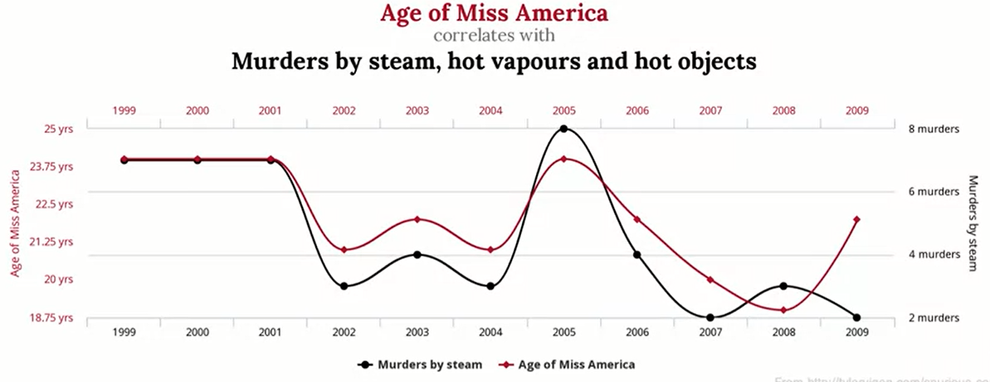
Spurious Correlations
These are correlations that are just "coincidences" due to the particular sample, and would probably not hold on longer samples / different samples

Slide 35

Spurious Correlations
These are correlations that are just "coincidences" due to the particular sample, and would probably not hold on longer samples / different samples

Slide 36
Summary
Hypothesis Testing
A hypothesis is a statement about a population parameter. You commonly have two hypothesis: the null hypothesis and the alternative hypothesis.
A hypothesis test gives you a rule to decide for which values of the test statistic you accept the null hypothesis and for which values you reject the null hypothesis and accept he alternative hypothesis.
A type 1 error occurs when an effect is due to chance, but we find it to be significant in the model.
A type 2 error occurs when we ascribe the effect to chance, but the effect is non-coincidental.

Slide 37
Summary
Significance level and p-values
A significance level is a probability threshold below which the null hypothesis can be rejected. You must choose the significance level before computing the test statistic. It is usually .01 or .05.
A p-value is the smallest significance level at which the null hypothesis would be rejected. The confidence interval contains the values of the statistic for which we accept the null hypothesis.
Correlations are useful as effects can help predict an outcome, but correlation does not imply causation.
When making recommendations, one should take into consideration confounding variables and the fact that correlation across two variables do not imply that an increase or decrease in one of them will drive an increase or decrease of the other.
Spurious correlations happen in data. They are just coincidences given a particular data sample.

Slide 38
Learning Recap
In this section, we discussed:
- Overview of hypothesis testing
- Bayesian approach to hypothesis testing
- An example of hypothesis testing involving coin-tossing
- Hypothesis testing terminology including Type I and Type II errors
- Examples of Hypothesis tests in practice
- Hypothesis testing: significance level and p-values
- Power and sample size considerations
- Correlation vs. causation
- Confounding variables
- Examples of spurious correlations

